Slide 1
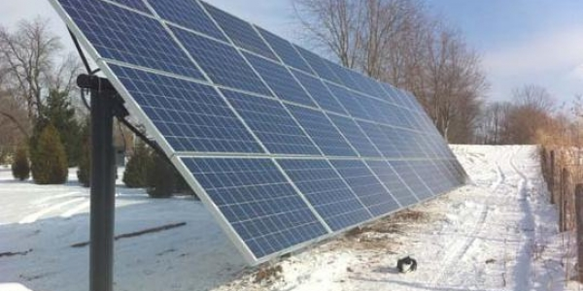
Energy and Agriculture

Slide 2
Introduction
Energy is a critical component in the production of food.
The primary or somewhat source of energy for the production of food was through the sunlight.
The plants usually obtain sunlight to use in the photosynthesis process so that food may be produced.

Slide 3
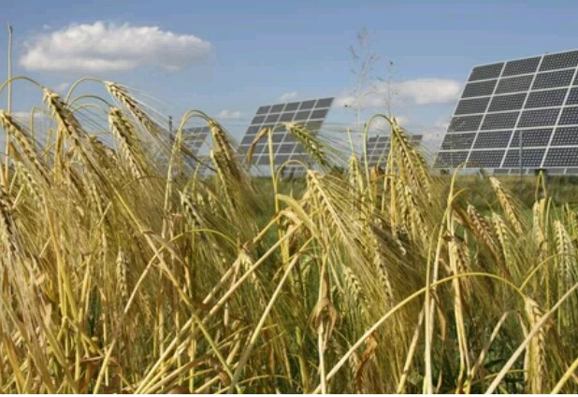
However, a time reached when agriculture was revolutionalized, and many new industries were developed.
These relied mostly on energy from fossil fuels which seem to be more reliable than the sun.

Slide 4
Agricultural Energy Inputs
Agricultural industries now make use of the fossil fuel for all their production services.
This entails the completion of various purposes which include fertilizer production, farm equipment, water consumption, and processing, transportation and packaging of the agricultural produce.

Slide 5
The energy derived from the fossil fuel ensures that more quantities of synthetic fertilizers and other fertilizer agents such as phosphorus and potassium are produced.
Also, the energy provides that water is consumed in the best way possible to enable processes such as waste management and manure flushing are completed successfully.

Slide 6
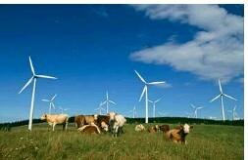
All farm equipment used in the agricultural industries relies mostly on energy obtained from fossil fuels.
Additionally, energy derived from fossil fuels is used to process and package the massive food productions in the industries.

Slide 7
Factory Farms and Energy Use
In the current times, most animal products are manufactured in the factories whereby they yield meat, dairy products, and eggs.
These animals produce these quality products without the access to any pastures.

Slide 8
Instead, the factories make use of the energy produced from fossil fuels to manufacture nutritive feeds which can be used by the animals since they do not access green pasture.
Factory productions lead to fast water and land pollution, and therefore there should be some companies to apply the extra energy generated to reduce the pollution.

Slide 9
This was before the industrial revolution was introduced in many countries.
The cycle, therefore, repeated itself through the reliance of plants on the sun to provide light for photosynthesis, plants to provide food for animals, animals to provide manure for the plants to grow back and repeat the procedure.

Slide 10
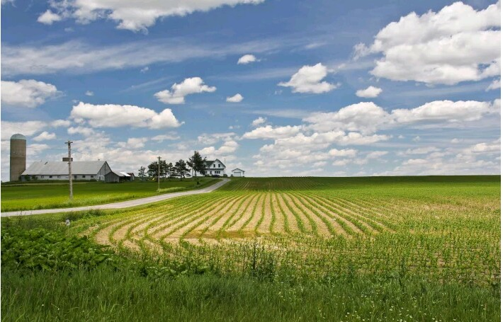
Some factories are known to make use of methane digesters which are more concerned with the generation of additional energy to produce electricity, and this cuts the cost.

Slide 11
For this kind of technology to remain viable within the factories, many issues have to be addressed so that it may cater for environmental, social, human health and other welfare problems which need to be immediately sorted.

Slide 12
Impact of Energy Policy
The energy policy is known to be harmful to the agricultural industry.
For instance, corn is used to produce energy through the use of ethanol, and this shows that a significant amount of corn is used for production.

Slide 13
It also means that this procedure reduces the availability of corn as food and therefore it results in the production of less food with the use of much energy.
Also, many resources get to waste because the output of corn requires a significant amount of water and this leads to wastage of resources.

Slide 14
Toward Energy-Sustainable Agriculture
A meaningful solution should be to improve the efficiency of energy for all food distribution and production.
This can be achieved through the transfer of intensive energy consumption to less extreme methods which consume less energy, and therefore this is, in the end, would save energy as well as cost.

Slide 15
Conclusion
In conclusion, many industries engage in the consumption of a lot of energy to produce agricultural products.
Therefore, it is their responsibility to look into means of how they can reduce the energy consumption and increase production at the same time.

Slide 16
This also calls for the use of the extra energy on the reduction of pollution in the environment.

Slide 17
Reference
Grace Communications Foundation. (2018). “Energy and Agriculture.” Grace Communications Foundation.

